Slide 1

Synapse Drive — ADAS Fuzzy Intelligence System A Hybrid Fuzzy-LSTM Approach for Real-Time Collision Risk Assessment
Submitted by:
Student Names & Enrollment IDs
Arnav Shukla E23CSEU0889
Manit Kumar E23CSEU0898
Yug Yash Nirwan E23CSEU0904
Supervised by:
Priyanka Gupta (Assistant Professor)
CSET326 - Soft Computing
School of Computer Science Engineering and Technology
Bennett University
April 2026
1

Slide 2
Abstract
Problem:
Autonomous driving systems need to handle uncertain sensor data
while remaining interpretable and responsive
Our Approach:
Hybrid model combining two soft computing techniques:
• Mamdani Fuzzy Inference System — rule-based, interpretable
• LSTM Neural Network — learns temporal risk patterns
Key Innovation:
• Adaptive weighted fusion (distance-dependent)
• TTC safety override for critical situations
• Physics-based fallback for edge cases
Tools: Python, scikit-fuzzy, TensorFlow Keras
2

Slide 3
Introduction - Background & Problem
Background:
• ADAS systems reduce human error — the #1 cause of road accidents
• Modern vehicles use sensor data (distance, speed) for collision avoidance
• Soft computing handles the uncertainty in real-world sensor readings
Problem:
• Fuzzy-only systems lack adaptability to temporal patterns
• Neural-network-only systems lack interpretability
• Need: A system that is BOTH interpretable AND adaptive
Our Solution:
• Hybrid architecture combining fuzzy rules + LSTM sequence learning
• Inputs: Distance (0–100 m), Relative Speed (0–100 km/h)
• Outputs: Brake Force (%), Collision Risk (%), Driver Alert (%)
3

Slide 4
Objectives
1. Design a Mamdani fuzzy inference system with 9 expert-driven rules
using trapezoidal + triangular membership functions
2. Train a 2-layer LSTM neural network for sequence-based collision
risk prediction using synthetic driving data
3. Integrate both via adaptive weighted hybrid fusion with
TTC-based safety override
4. Evaluate across 9 scenarios including 3 edge cases
5. Provide an interactive web dashboard for real-time testing
4

Slide 5
Literature Review — Key Foundations
Fuzzy Logic (Zadeh 1965, Mamdani & Assilian 1975):
• Linguistic variables handle sensor uncertainty
• IF-THEN rules are human-readable and auditable
• Widely used in automotive control
LSTM Networks (Hochreiter & Schmidhuber 1997):
• Memory cells capture long/short-term temporal patterns
• Gating mechanisms (input, forget, output gates)
• Ideal for sequential driving pattern analysis
Hybrid Rationale:
• Fuzzy → interpretability + expert knowledge
• LSTM → adaptability + temporal trend detection
• Weighted fusion → best of both worlds
5

Slide 6
Literature Review — Related Work
Approach Strength Weakness
───────── ──────── ────────
Fuzzy Only Interpretable Not adaptive to sequences
LSTM Only Adaptive Black-box, hard to audit
Our Hybrid Both Synthetic data limitation
Key References:
[1] Zadeh (1965) — Fuzzy sets theory
[2] Mamdani & Assilian (1975) — Linguistic synthesis
[3] Hochreiter & Schmidhuber (1997) — LSTM architecture
[4] Li et al. (2020) — DL-based vehicle risk assessment
6

Slide 7
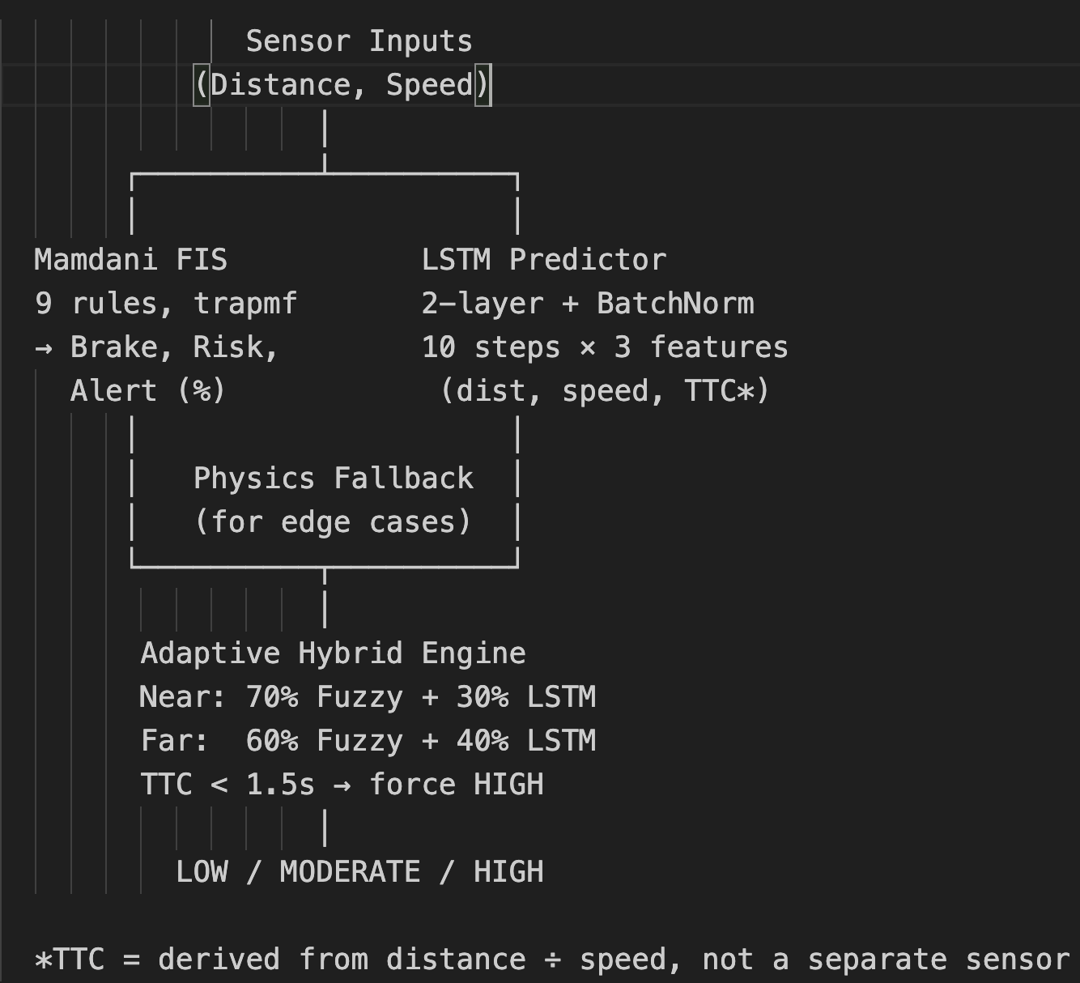
Methodology — System Architecture
7

Slide 8
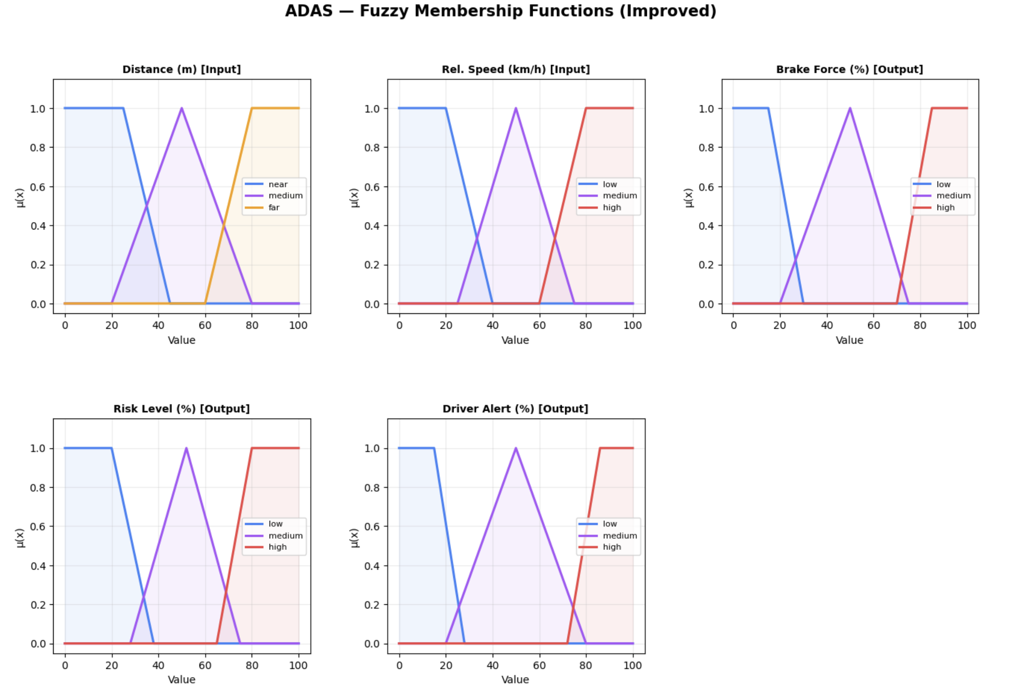
Methodology - Membership Functions
Design choice:
• Boundary sets (Near, Far, Low, High) → Trapezoidal
Flat top at edges prevents NaN/zero bugs
• Interior sets (Medium) → Triangular
Peaked response in mid-range
Example — Distance:
Near: trapmf [0, 0, 25, 45] → μ=1 for 0–25m
Medium: trimf [20, 50, 80] → peak at 50m
Far: trapmf [60, 80, 100, 100] → μ=1 for 80–100m
All 5 variables × 3 terms = 15 membership functions total
8

Slide 9
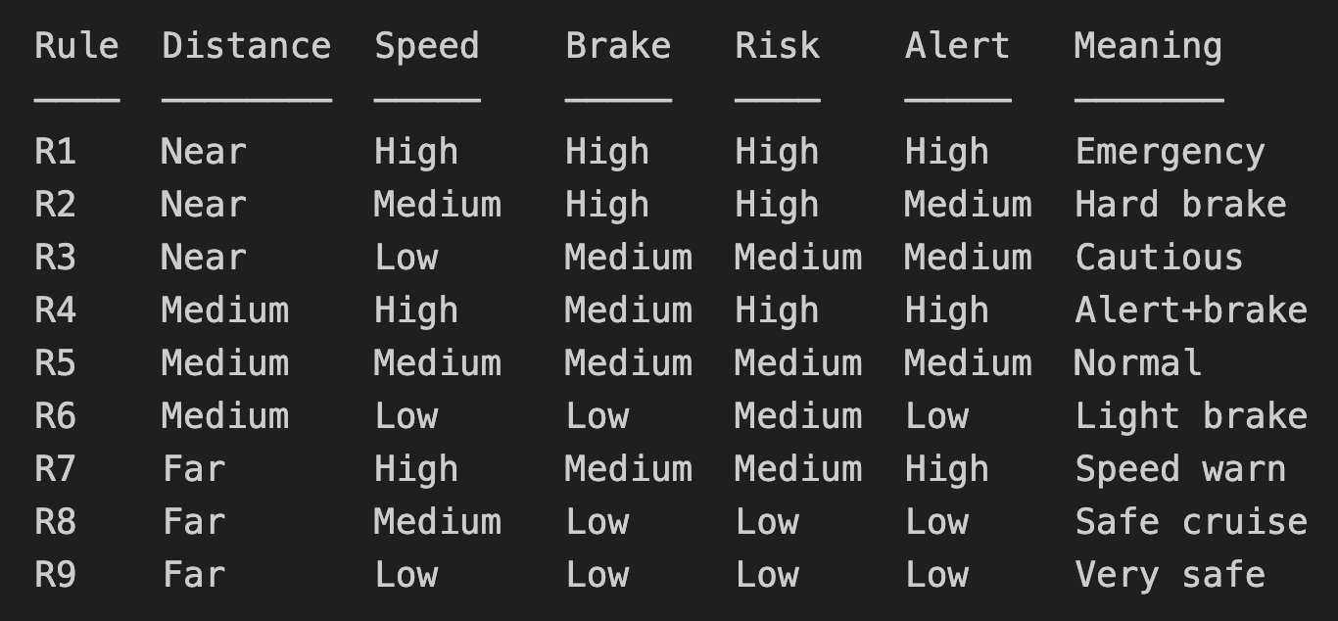
Methodology — Rule Base
9 rules = all 3×3 combinations covered
Defuzzification: Centroid method
Edge cases: Physics-based TTC fallback
9

Slide 10
Methodology — LSTM Network
Data Generation:
• 3000 sequences × 10 timesteps × 3 features
• Features: distance, speed, normalized TTC
• TTC = distance ÷ (speed_m/s) — derived feature
• 50% safe, 40% risky, 10% edge cases
Architecture:
LSTM(64) → Dropout(0.25) → LSTM(32)
→ BatchNorm → Dropout(0.2)
→ Dense(16, ReLU) → Dense(1, Sigmoid)
Total: 30,497 parameters
Training:
• Adam (lr=0.001), Binary cross-entropy
• EarlyStopping on val_AUC (patience 6)
• ReduceLROnPlateau (factor 0.5, patience 3)
• 80/20 stratified split
10

Slide 11
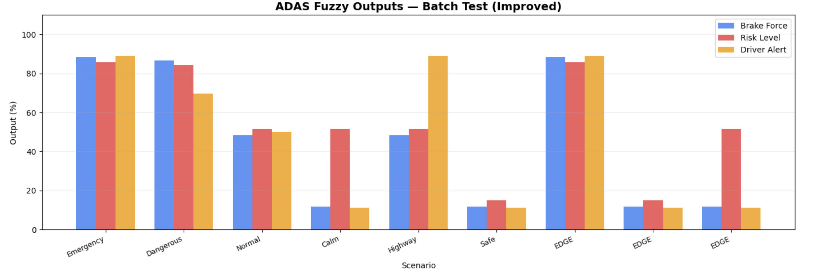
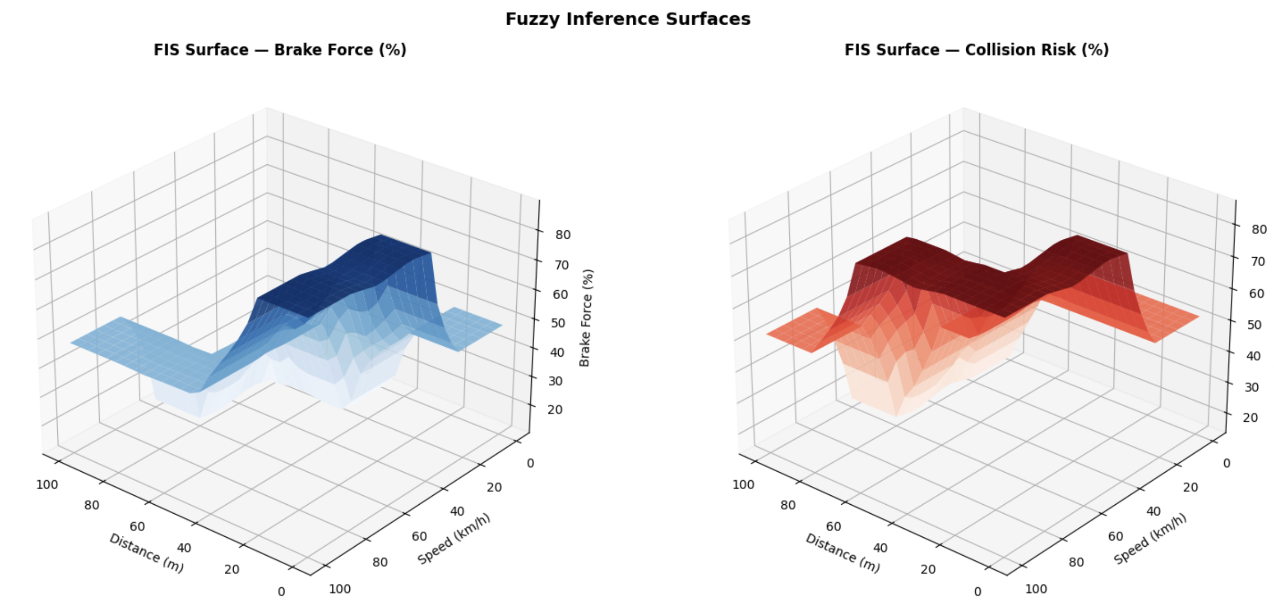
Results — Fuzzy Outputs
Scenario Evaluation:
Emergency (5m, 90km/h) → Brake 86%, Risk 86%, Alert 89%
Normal (50m, 50km/h) → Brake 48%, Risk 52%, Alert 50%
Safe (95m, 10km/h) → Brake 12%, Risk 15%, Alert 12%
Edge (0m, 100km/h) → Physics fallback → all HIGH ✓
3D Surfaces:
Smooth gradients, no dead zones
Brake/Risk increase as distance↓ speed↑
11

Slide 12
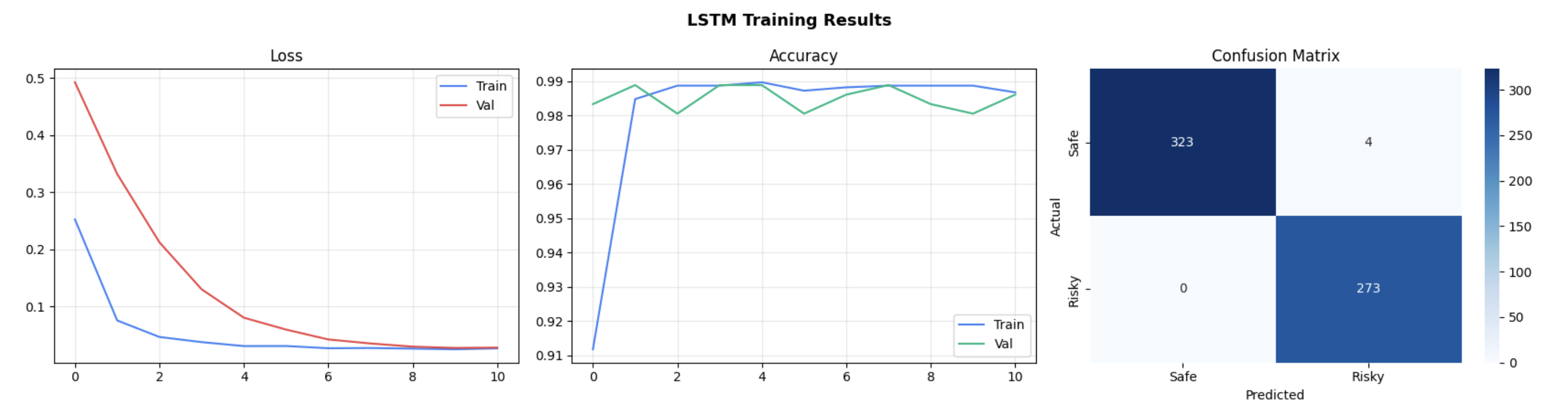
Results — LSTM Performance
Test Accuracy: 99.3% Test AUC: 1.000
Confusion Matrix:
Predicted
Safe Risky
Actual Safe 323 4
Risky 0 273
• 0 false negatives — never misses a dangerous scenario
• 4 false positives — conservative (over-warns) = safer
Why 99%?
Synthetic data has well-separated classes
Real-world data would give ~80-90%
This is acknowledged as a limitation
12

Slide 13
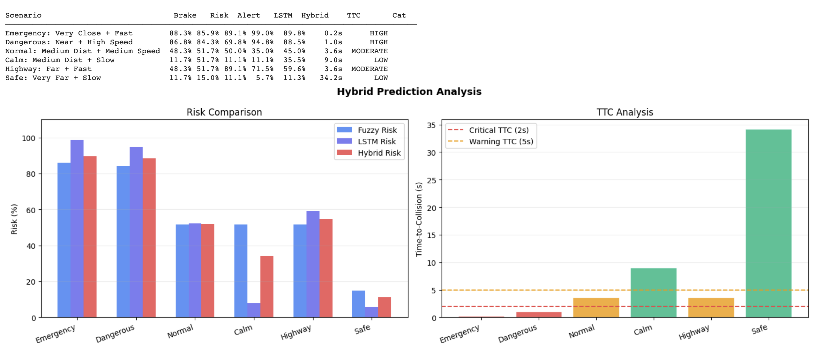
Results — Hybrid Model
Adaptive Fusion:
R_hybrid = w_fuzzy × R_fuzzy + w_lstm × (100 × P_LSTM)
Distance < 20m: 70% Fuzzy + 30% LSTM
→ Trust rules more at close range
Distance ≥ 20m: 60% Fuzzy + 40% LSTM
→ LSTM temporal context valuable at distance
TTC Safety Override:
If TTC < 1.5s → hybrid risk ≥ 75% (forced HIGH)
13

Slide 14
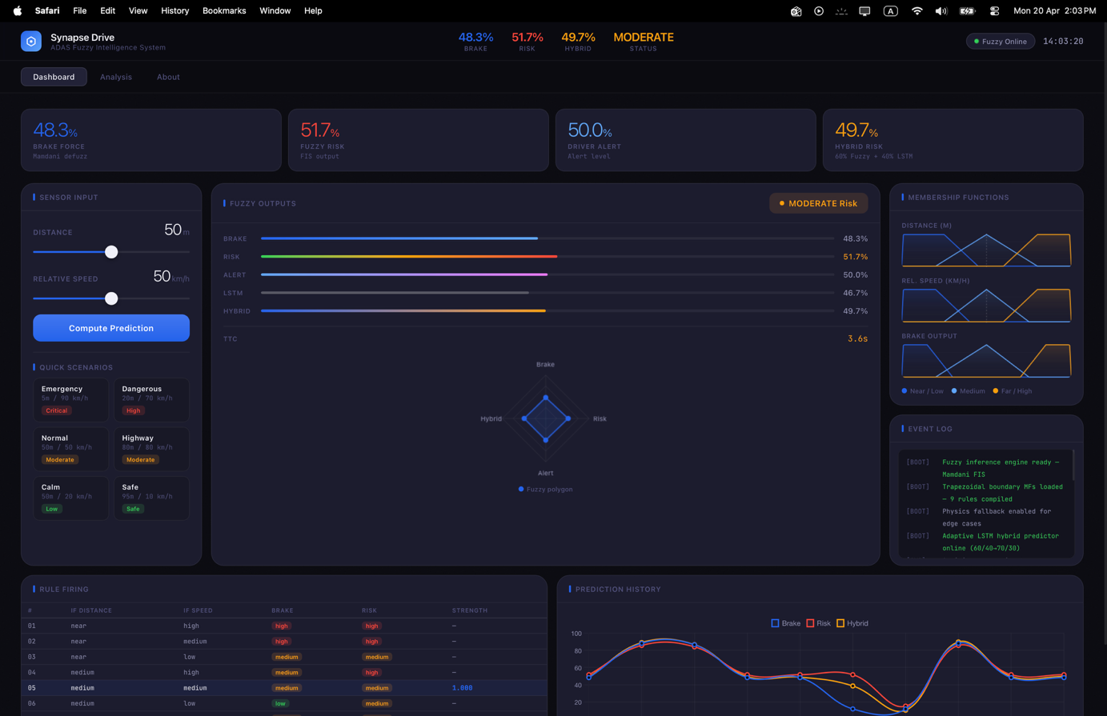
Results — Interactive Dashboard
Web dashboard: adas_v3_blue.html
Built with: HTML + React.js + Chart.js
Runs in browser — no server needed
Fuzzy engine reimplemented in JavaScript
Three tabs:
Dashboard: Sliders, live outputs, radar chart,
rule firing table, prediction history
Analysis: Scenario comparison, inference heatmap
About: Architecture docs, full rule table
14

Slide 15
Conclusion & Future Work
What We Built:
✓ 9-rule Mamdani FIS with trapezoidal boundary MFs
✓ LSTM trained on 3000 sequences (dist, speed, TTC)
✓ Adaptive hybrid fusion with TTC safety override
✓ Web dashboard for interactive testing
Limitations:
• Synthetic data (not real-world driving logs)
• 2 sensor inputs only + TTC derived
• No hardware deployment
Future Work:
→ Real datasets (KITTI, nuScenes)
→ Multi-sensor fusion (radar, camera, LiDAR)
→ ANFIS for auto-tuning MF parameters
→ Edge deployment (NVIDIA Jetson)
Thank You !
15

